Slide 1

PROJECT MANAGEMENT APPLICATION

Slide 2
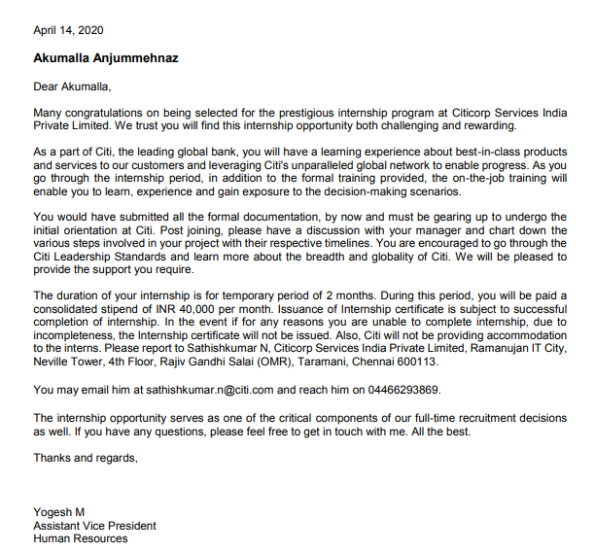

Slide 3
Technologies Used
Eclipse IDE
MySQL Work-bench for Database management system
Java for programming

Slide 4
Schedule
Week 1 : Designing database tables
Week 2 : Designing architecture of the application
Week 3 : Programming applets
Week 4 : Connectivity of front end and back end using java and Mysql
Week 5 : Correction of errors and Improvization

Slide 5
Purpose of Project Management Application
To improve Team Productivity that promotes smooth workflow.
To track the status of the project and manage tasks to fulfill a project’s need.
To be able to view the big picture of every project within the timeframes set in order to achieve the desired outcome.
Easy accessing of data.

Slide 6
Advantages
Reliable data storage and security.
Easy Documentation.
Runnable file that can be carried anywhere easily and cannot be corrupted.
Multi-tasking promoted by multiple frames on the application.
User authorization and permissions for administrative tasks.

Slide 7
Enhancements
Search for database
Graphical Representation of the status of the project.
Calendar view of time sheet, tasks and deadlines.
Notification pop-ups in case of newly allotted tasks or deadlines.
Raising Tickets for user permissions.

Slide 8
Thankyou

